Slide 1
NLMS Adaptive FIR Filter Design.
AIM OF THE PROJECT
This aim of the project is to address problems regarding training an FIR filter to mimic the response of certain desired target filters using an FPGA. Traditionally, implementing changes in filter responses in an FPGA is hard because it involves re-programming, but with an adaptive algorithm like the NLMS method programmed in an FPGA, we can attach any dsp/ prototype filter in parallel and train it in a short period. The problems that arise with this have to do with the limitations of the adaptive algorithm and some fundamental differences in filter structures/ the prototype being an analog / digital filter. Therefore, with this knowledge we can make educated guesses on the parameters of target/adaptive filter to choose in order to obtain a desired frequency response.

Slide 2
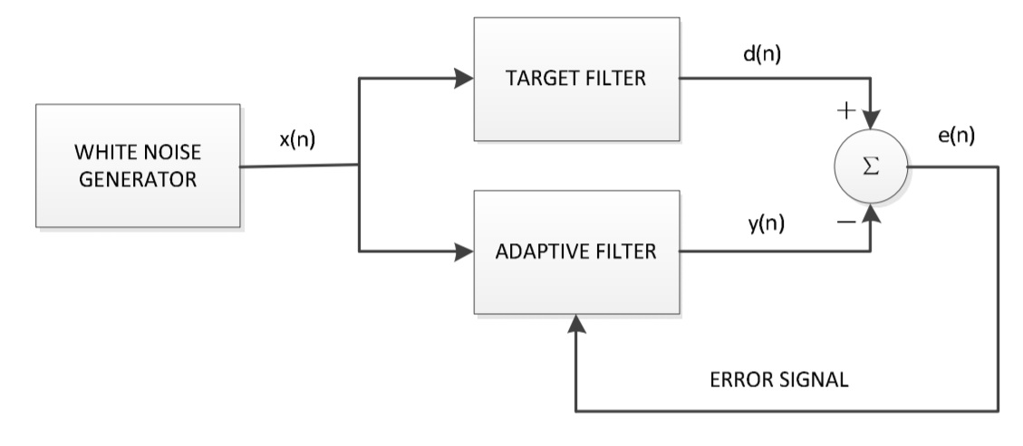
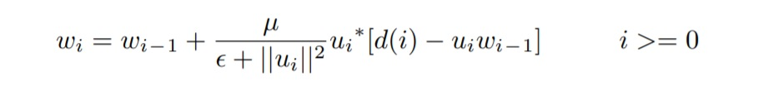
NLMS Adaptive Filter Set-up
We use a white noise generator to give the same input to the Adaptive and Target filter and calculate the error in outputs and adjust the adaptive filter weights accordingly as shown in the right.
The input signal is uniform 1 PSD white noise to ensure there’s no bias of any frequency in the input while training the filter.
The NLMS filter takes the direct form FIR structure as shown as shown in the next slide. It’s because of this that once training is done, it can be directly used as an estimated FIR filter.
The Algorithm is as shown below:

Slide 3
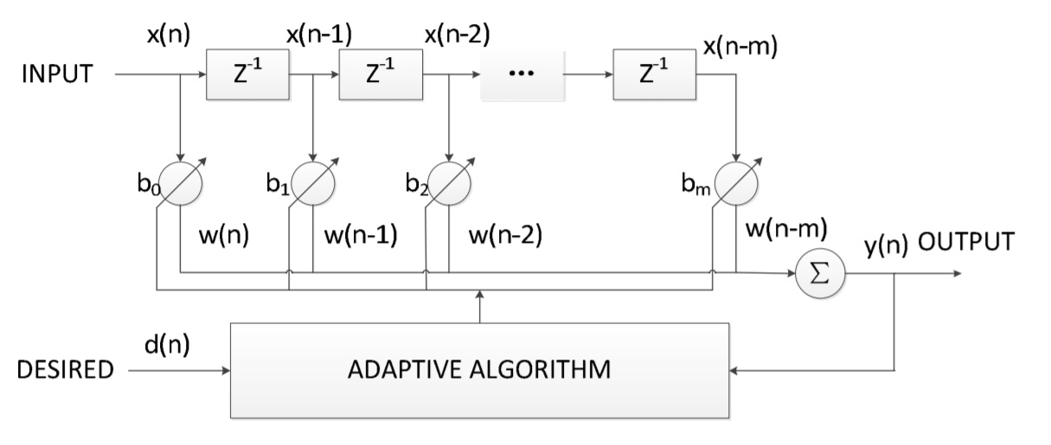
Direct Form NLMS FIR structure

Slide 4
Performance with different kinds of target filters
PART 1: An FIR target filter of equal length as the adaptive filter.
We primarily deal with 3 different FIR target filters: Multiband Equiripple filter , Multiband Hamming window filter and the lowpass Kaiser window filter roughly of order ~ 100 , trained for 20s with a step size of 0.01 in order to see the performance over different design methods.
What we observe:
We see that all three filters achieve convergence in phase and magnitude after 20s of training. We can confirm convergence from the squared norm of weight vector plot, where the weights attain a steady state value. The reason for this convergence is probably because of the similarity in the structures. Both have the same tap length FIR structure and with a small enough step size, it should converge.
Now, we change the time to 5s and observe the transient process. For the Equiripple Filter, we see there’s convergence in magnitude, but not in phase. This is because errors in coefficients dominate over the magnitude in certain attenuated areas of the frequency response. Although both of them may be very small, relative error being high gives high error when dividing two quantities and this being a part of the phase calculations creates high deviations in phase.
Comparing mag. responses of the three filters at 5s, we see that theres increasing convergence in the following order: Equiripple filter> Kaiser window filter> Hamming window filter. This is because theres lesser variation in frequency responses in the same order. The variation is mainly due to ripples. In the equiripple case, we find there are uniform ripples everywhere, however for the Hamming window filter the ripples vary a lot with bigger jumps. The Kaiser window response has gradually decreasing ripples. These ripples add to variance in desired output and changes the update parameter rapidly. Also, for a highly varying d(i) the instantaneous approximation becomes less efficient.

Slide 5
Takeaways:
This tells us that its fairly easy to adapt for a target FIR filter using the same order. Convergence can be achieved for different filters in a matter of seconds (~20s in this case) even for an order of ~ 100 with a small enough step size using the NLMS algorithm.
We have to have enough training time for achieving a good phase response, but if we are interested only in the magnitude response, we can reduce it.
If we are given certain specifications of the filter, we should choose the prototype designed by a method that ensures gradual variations in it’s response for better tracking of the adaptive filter.
In general, the progress of the squared norm of the weight vector with time can be a test for convergence.

Slide 6
PART 2: A low order IIR Filter Target
We try to achieve the response of a bandpass IIR filter of a low order (~10) using a high order FIR adaptive filter(~100). We notice that the magnitude response almost fully converges while the phase response diverges at the ends of the spectrum. In order to improve the response, we try two cases: increasing order of adaptive filer/ decreasing step size with more training data. Upon increasing the order a bit, it’s seen that the phase response also converges almost fully with minor deviations in the edges. When we decrease step size and take even 10 times training data, we observe no major difference from the original result. Now, we try to see if there’s a more efficient way to estimate using lower no. of coefficients as well. Hence, we come up with an Adaptive IIR Model Filter where a modified weight vector and input regressor is used to estimate the coefficients as shown below:
Modified difference eqn( bi and ai are num. and den. coeffs) for IIR Response:
d(n) = b1∗u(n)+b2∗u(n−1)....+bm∗u(n−m+1)−a2∗d(n−1)−a3∗d(n−2)...−ap∗d(n−p+1)
Weight vector:[b1 b2 b3...bm -a1 -a2 -a3 ...-ap ] , a1 =1
Input regressor:[ u(n) u(n-1) ... u(n-m+1) d(n-1) d(n-2) ...d(n-p+1)]
This way the length of the weight vector is just 2*order +1. We observe that for a training time of 20s this process doesnt hit convergence and the magnitude and phase responses are way off the Target response.

Slide 7
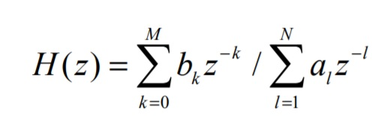
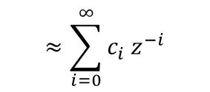


What do we observe:
We see that the phase initially doesn’t converge at the edges because the IIR and FIR filter structures are itself different. Infact, the magnitude response varies slightly at ~ -100 dB. The phase only diverges at the edges since the magnitude is very low there implying the error in the coefficients (w.r.t let’s say an infinite order approx. of the IIR response) although small, would be relatively higher than the magnitude of the values themselves. This causes a high error when dividing for calculating phase.
$$≈\sum_{i=0}^{∞}{c_{i} z^{−i}}$$
FIR: New mag. $∝\sqrt{{\left(x+∆x\right)}^{2}+(y+∆y)^2}$
New phase $∝t{an}^{−1}{(}(y+∆y)$/$\left(x+∆x\right) )$
On increasing the order, we obviously obtain a better approximation for this infinite order polynomial, hence a better result. Another interesting result obtained is the pole zero plot where the FIR filter tries to surround the target filter’s outer most poles with its zeros in a circle in an attempt to mimic the response of boosting the freqs. at the poles by zeroing out all the other frequencies in that unit circle. Ofcourse, it doesn’t do it for all the target poles and additionally has its own repeated poles at origin.
Nothing new happens on decreasing step size because even though it hits convergence, a filter with the same order can’t give more zeroes to surround the outermost poles and obviously give a better approx. to the inf. order polynomial.
Finally, the IIR adaptive model too, doesn’t give a good result after 20s. This is because of the inefficiency of the instantaneous approximation that goes into the new input regressor having d(i) terms. d(i) is dependent on u(i -1) etc. and we can’t combine the contribution of all those inputs into one value d(i) and use it for the covariance approximation. Now, obviously the problem here is that with older d(i), the u(i) used would be very old. Hence, the approximation isn’t instantaneous anymore. Hence, it hasn’t hit convergence yet. We would need extremely high sampling rates and training time for convergence.

Slide 8
Takeaways:
When approximating an IIR filter, we can’t be guaranteed of phase convergence. We have to do some tweaking in the order only to try to achieve convergence in phase and magnitude. The order of the FIR filter used was approx. 10 times that of the IIR filter. So, we need high tap lengths for approximation.
Changing step size to try to get better convergence doesn’t work, because we need more zeroes and hence we have to increase the order only.
Phase response only diverges at the edge frequencies, other parts are still the same (with a shift of ~2pi or some multiple).
If we want exact convergence (which we can’t do with an FIR filter) we can attempt to use the IIR Adaptive Model provided you have extremely high sampling rates and allow high training times.

Slide 9
PART 3: FIR filter target with larger length
Here, we try to approximate a target lowpass Hann FIR filter with higher order than the adaptive filter’s for two cases- target order 20 and 70 . We also use a comparing filter of same order as the adaptive one to see how close it’s response is to the target’s and to verify whether the adaptive FIR could converge reasonably. For the target filter of order 20, we adapt using an FIR filter of order 18 and it’s seen that it does converge to the target magnitude response well. Infact, it does it better than the traditional FIR (order 18) comparing filter. However, the phase response diverges roughly at the start of the stopband. Now, we see how low an order can the adaptive FIR take. It’s seen it can’t go below 17,mag. Resp. starts diverging at 16. It’s intuitive that there’s more convergence as we increase the order of the Adaptive filter. To see how this lower limit varies as we increase the order of the target filter, we change it to order 70. An adaptive FIR of order 68 and 67 are used. It’s seen that the order 68 filter gives almost full convergence in mag. Resp. while the order 67 filter gives a sudden diverging response in the beginning of the stopband.
What do we observe?
The Adaptive FIR filter’s mag. Resp. characteristics like roll-off and stopband attenuation is closer to the target filter’s than the comparing filter of same order because the adaptive algorithm by nature tries to have it’s response as close to the target filter’s as possible, but the comparing filter tries to attain the specifications of the filter as close as possible (in this case using a Hann window). So, parameters like roll-off, stopband attenuation are set accordingly.
The phase response diverges at a freq. of 0.7, because that’s where the stopband roughly starts and as we saw earlier, low magnitude implies even small error in coefficients could result in high changes in phase.
Finally, for the 20th order target filter, we saw divergence at order 16, because it’s comparing filter would be pretty different from the original. However, for a 70th order target, we can’t reduce the adaptive FIR order below 68. This is because as we increase the target filter order, we see more ripples in the stopband ,hence more variation that gives more variance in d-desired ouput resulting in greater s.s. MSE. So, atleast when a higher order FIR gives more ripples, we can say performance of the Adaptive filter becomes more sensitive to changes in it’s order.

Slide 10
Takeaways:
If we use a lower order FIR to approximate a higher order one, to obtain a converging magnitude response atleast, we would still need to be pretty close to the target order allowing maybe~3-4 orders difference. This condition becomes more stringent when you want convergence in phase.
We’ll need a closer order to target when the target order increases and variation/ ripples increases with order.
Finally, if we want a better response with a lower order, we can use the adaptive method ( as long as it shows good convergence), since the traditional filter of same order wouldn’t give as good a roll-off/stopband attenuation,etc as the target filter which the adaptive filter mimics.

Slide 11
PART 4: An IIR Target far exceeding the edge
In this section, we see what happens when we increase the order of the IIR filter using the same length Adaptive FIR(99). We use a target Butterworth Bandpass IIR filter of orders 14,18 and 50 to see how the performance varies. For order 50, what we see is that the magnitude response is almost same for high values and diverges after a point in the transition band and as we decrease this order, we attain more and more convergence. It gives large convergence for order 14. Next, we use a Chebyshev type 1 Bandpass filter of order 10 which has a pretty high roll-off and see the outcome. Now, its seen that for the same adaptive FIR, theres divergence for this filter of order 10 due to the high roll-off.
What we observe:
The mag. Resp. converges on the top and then outlines the transition band and diverges because, the input signals with frequencies at the stopband have outputs which are feeble and hard to detect. The errors in the adaptive filter coefficients would dominate and cause the mag. Resp. to rise and diffuse. This is why in the chebyshev filter with high-roll off, outputs for more frequencies would be hard to detect giving more divergence.
We see a more converging result as we decrease the IIR filter order since, as seen earlier by the infinite order approximation of the IIR filter, increasing the difference between the adaptive and the original filter’s order gives a better approximation.
There is divergence even for a small target order of 10 in the Chebyshev filter since it has a high roll-off giving more variance across frequencies. We already know more variance in d-desired o/p means more s.s. error.

Slide 12
Takeaways:
We now know to always use a lower order IIR filter(~10-20) for certain frequency specs. to adapt an FIR filter of given length(in this case 99).
We can make educated guesses on the order of an IIR filter to be used based on it’s steepness/ roll-off so that the Adaptive FIR gives a stable response.
The order of adaptive filter required for a higher order IIR filter( ~ 50 or more) would be extremely high and sometimes impossible to obtain a stable response.

Slide 13
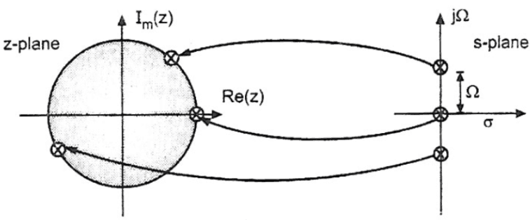


PART 5: A passive Analog target filter
So far, we have tried to adapt an FIR filter to digital filters. Now, we try to estimate the FIR coefficients for a target lowpass Butterworth analog filter of order 8 on SIMULINK. We use an A/D converter (sampled at 8Khz) at the output of the analog filter to discretize it and feed it as a desired signal to an NLMS filter block(length 99). Using white band noise as input for both filters (sampled at 8Khz) , we obtain the estimated weights of the Adaptive FIR from the ‘wts’ port of the NLMS block. We train for 20s, using a step size of 0.01. We observe that the magnitude response for the lower order analog filter and that of the Adaptive FIR filter are close but differ a little .
What we observe:
The magnitude responses of the Adaptive FIR and the low order analog filter differ little near the cutoff frequencies and higher. Normally digital filters are built with an analog prototype using some form of transformation like Bilinear transform/ impulse invariance. Although, here we just feed in a continuous signal and sample the output of the analog filter to discretize it so we can’t exactly tell the digital domain transfer function for this set-up. So, we know that we are in a sense estimating an unknown digital IIR filter whose response is close to its analog counterpart. One possible explanation is that we can say this digital IIR filter could be close to a bilinear transform of the analog filter. Bilinear transform basically maps the imaginary axis of the s-plane to the unit circle in the z plane. Because of this non-linear transformation, it’s known to give higher roll-offs in IIR digital filters and more deviation closer to nyquist frequencies. This is why we see the analog mag. Resp is higher than the estimate( close to the digital IIR resp.). Additionally we can see convergence via the dot product of the weight vector.
Bilinear Transform:
$$\frac{2(z−1)}{T(z+1)}$$
z = (1+ sT/2)/(1-sT/2)
$$s=$$

Slide 14
Takeaways:
This shows that the NLMS algorithm works even for analog filters of a low order and it shows reasonable convergence in magnitude response using a high order adaptive FIR filter.
We can’t get exact or almost perfect convergence due to it being an analog filter. Hence, for a better estimate we would go for a digital IIR target filter of the same order and close enough response to obtain better results.
We still haven’t taken into account of noise in analog filters which would make the estimates more off.
Finally, we can say that the Adaptive FIR NLMS filter is useful in replicating responses of different kinds of filters, analog ,digital , FIR, IIR , lowpass, bandpass, etc. having a lower or higher order with some pros and cons based on which we make some educated guesses in order to obtain the frequency response we want on the FPGA as close as possible via adaptive training.

Slide 15
THE END

